Slide 1

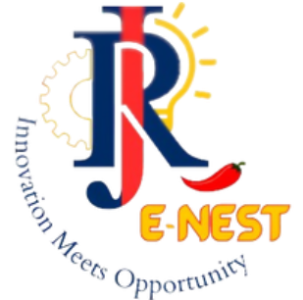




SMART INDIA HACKATHON 2026
TITLE PAGE
Problem Statement ID – SIH26140
Problem Statement Title-AI-Based Interactive Quantum Algorithm Learning Platform
Theme-Smart Education
PS Category- Software
Team ID-
Team Name – Cognitive Crew

Slide 2
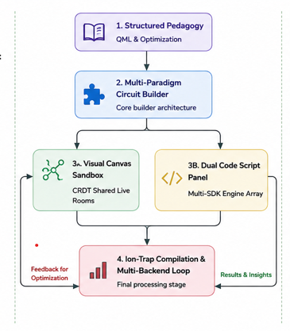
Qurio— Hardware-Aware Intelligent Quantum Workspace
Cognitive crew
Problem:
Our Idea:
Standard quantum resources treat quantum computing as purely abstract math, producing developers unaware of real hardware constraints like gate noise and connectivity limits.
A hardware-aware, multi-SDK quantum circuit sandbox that combines a visual node canvas and a live multi-SDK code panel, peer collaborative debugging rooms, and intelligent tutoring that tracks progress from Qubits to QML, auto-grading exercises with hidden checks.
Proposed Solution:
Multi-Framework Circuit Sandbox: Node-based canvas produces a consistent OpenQASM 3.0 circuit, and a Monaco code editor is used for running Qiskit, Cirq, and PennyLane programs.
Peer Collaborative Debugging: Rooms are built on the Spring WebFlux stack, where CRDTs ensure consistency to avoid edit conflicts even with unreliable lab router connections.
Intelligent Tutoring: Tracks your progress from Qubits to QML & Optimization, and automatically grades assignments using check vectors.
Innovation/Uniqueness:
Hardware-Aware Intelligent Quantum Workspace
A truly intelligent quantum workspace that goes beyond the abstract mathematical formulation, bringing in practical hardware limitations like noise levels, connectivity challenges and coherence times.
A combined Visual Canvas and Dual Code Script Panel for an OpenQASM 3.0 workflow.
Collaborative rooms that can coordinate multi-user debug sessions with CRDTtechnology ensuring no conflicts occur over unreliable lab network connections.

Slide 3
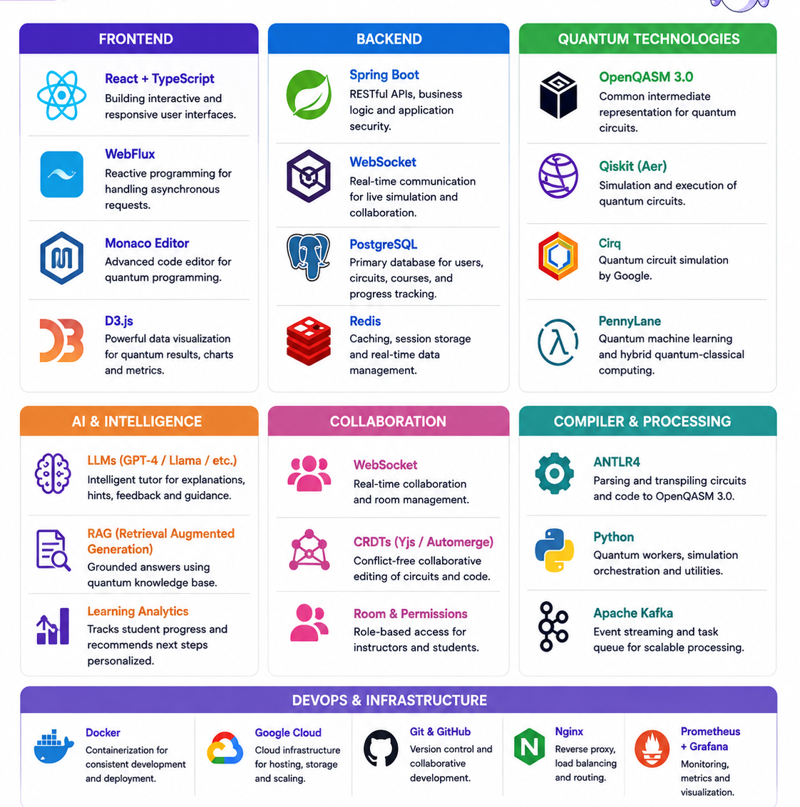
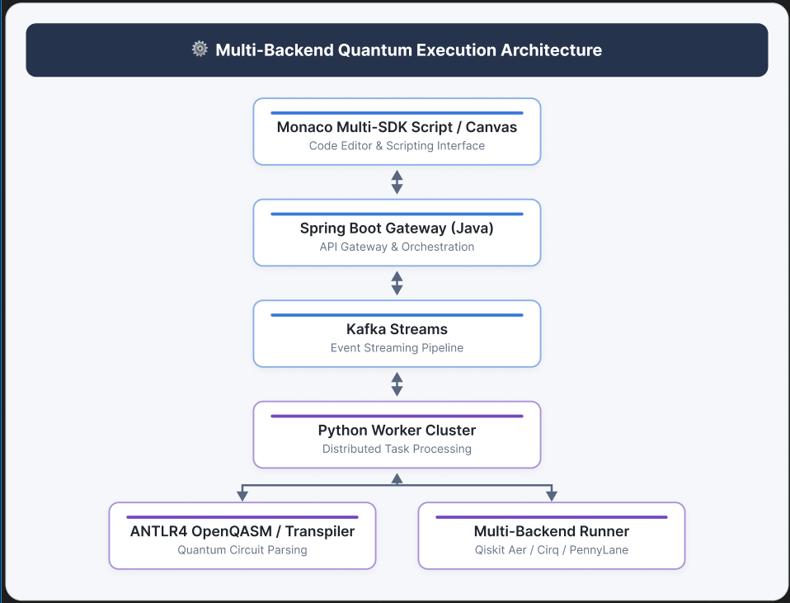
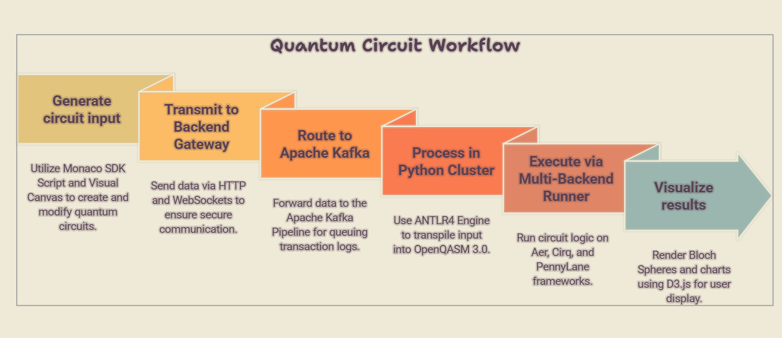
TECHNICAL APPROACH
Cognitive crew
Technologies used:
.
Methodology / Implementation flow:
Monaco multi-sdk script/visual canvas feeds circuit data into the Spring Boot Gateway
The Gateway forwards the request via Kafka to the Python worker cluster
ANTLR4 compiles the visual/code input into an openqasm 3.0 pipeline
Multi backend runner executes the sdk loop match (AerSimulator/cirq.Simulator/PennyLane)
D3.js visualization renders Bloch spheres, probability plots and circuit statistics

Slide 4
FEASIBILITY AND VIABILITY
Cognitive crew
FEASIBILITY
Sandboxed & CPU-Bound: Simulations limited to N ≤ 12 qubits / workspace due to CPU resource constraints.
Multi-SDK Stack: Includes Qiskit Aer, Cirq, and PennyLane running in isolated subprocesses.
Phased Rollout: P1 → P2 → P3 → P4 development lifecycle.
Grounded RAG: Groq-hosted LLM ground-truths region-of-interest language models.
CHALLENGES
AI Hallucination → Code parsed through Qiskit/Cirq sandbox syntax checks
Variable Server Load → N ≤ 12 Qubit compute ceilings enforce isolated spikes
Sync Collisions → CRDT-based conflict resolution across live-rooms
Misconception Mapping → Java classifier cross-references error patterns against a misconception matrix
STRATEGY
P1 – Core Sandbox: React + Spring Boot gateway; OpenQASM drag layouts + Monaco editor.
P2 – Execution Pipeline: FastAPI containers (Qiskit/Cirq/PennyLane) emit Bloch/probability telemetry.
P3 – AI Tutor: ANTLR4 + Clifford+T scorecard; RAG over Groq.
DEPLOYMENT
Client Node: Browser-based, 4 GB RAM minimum ceiling.
Local Server: 4-core vCPU / 16 GB RAM classical deployment option.
P4 – Collaboration: Yjs WebSocket engine for multi-collaborator rooms + instructor analytics.
No Server GPUs: Bounded 12-qubit state-vectors complete on standard classical CPUs.
VIABILITY
Freemium SaaS: Free core modules; premium certification pathways for students.
Academic B2B Tier: University subscriptions with analytics, curricula & instructor dashboards.
National Alignment: Directly supports India’s National Quantum Mission skilling pillar.
Growth Path: Certification tracks in QML for Logistics & Ion-Trap Algorithms.

Slide 5
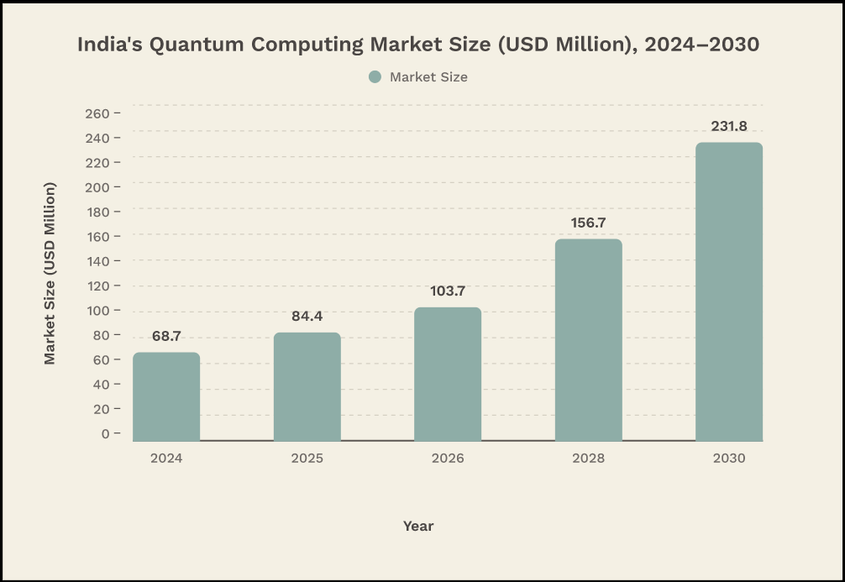
IMPACT AND BENEFITS
Cognitive crew
The Educational Bottleneck
Purely Mathematical Instruction: Classes end with linear algebra and Dirac notation, where students manipulate equations on paper without ever seeing the circuit malfunction in actual devices.
Hidden Constraints: The effects of gate noise, limited connectivity, and coherence time remain invisible until students encounter real devices and everything falls apart.
Lack of Error Diagnosis: Students fail to learn what makes their circuit malfunction; they only know it malfunctions.
Simulation Only Instruction: Students become confident through the use of ideal simulations, which are devoid of any noise.
Platform Differentiator
Live Hardware Sandbox: Presents challenges of noise, connectivity, and coherence as the circuit is being assembled rather than once it breaks down.
CRDT Multiplayer: Collaborate on writing and debugging circuits together in real-time within a single session, using hidden-check grading under the hood.
Regional AI Assistance: Instantaneous, context-based assistance using Groq-hosted RAG in Hindi, Telugu, and Tamil languages.
Multi-SDK Compatibility: Maintains the platform agnostic by virtue of its framework with OpenQASM 3.0 + ANTLR4 transpilation.
Policy & National Relevance
Alignment with NQM: Supports the aim of India’s National Quantum Mission of developing a quantum-ready workforce.
Scope of Reach for Institutions: A freemium model that is designed to scale among colleges and universities and not individuals.
Timing of Strategy: Ensures India’s talent pipeline is ahead of the worldwide race for quantum hardware.
Source: India Quantum Ecosystem Market Projection Report 2025.

Slide 6
RESEARCH AND REFERENCES
Cognitive crew
Academic Grounding
Curriculum syntax is cross-checked against the IBM Quantum Learning platform, Google Cirq and Xanadu PennyLane documentation.
The Ion-Trap optimization scorecard is grounded in real shuttling-limitation and Rydberg-coupling constraints.
AI regional-language analogies are RAG-grounded over course material to reduce hallucination risk.
Tools & APIs Used
Groq endpoints running Llama 3.3 70B — RAG-based regional-language remediation.
groq.com
Apache Kafka — transaction log & telemetry streaming for the worker cluster.
kafka.apache.org
Spring Boot (Java 21) & React 18 / TypeScript — gateway and sandbox front end.
spring.io/projects/spring-boot · react.dev
Technical References
Qiskit Aer, Cirq & PennyLane — multi-backend simulation and state-vector visualization engines. quantu
m.cloud.ibm.com/docs · quantumai.google/cirq · docs.pennylane.ai
OpenQASM 3.0 — unified intermediate representation generated by the ANTLR transpiler.
openqasm.com
IBM Quantum Learning, Google Cirq & Xanadu PennyLane guidelines — used for curriculum syntax validation.
Note
Links above point to each tool’s official documentation home page, not a version-specific page, since SDKs update frequently.
Figures and technical claims reflect the team’s own design and these publicly documented capabilities as of submission.

